Slide 1
Neural-Prosthesis
By: Luke P. Wandelear

Slide 2
What type?
Specifically pertaining to the Hippocampus
Plays major role in the brain’s memory

Slide 3
http://en.wikipedia.org/wiki/File:Hippocampus.gif

Slide 4
Functions and Location of Hippocampi
The Hippocampus is located in the Medial Temporal Lobe of the brain
It handles parts of memory that can be explicitly vocalized

Slide 5
Possible Different Damages to Hippocampi
Disease
Bunt trauma
Damage caused by the choices of the person

Slide 6
Cause of the Damages…
Diseases like: Schizophrenia, Alzheimer's, and Parkinson’s
Blunt Trauma: any type of accident that causes brain damage/bruising/concussions

Slide 7
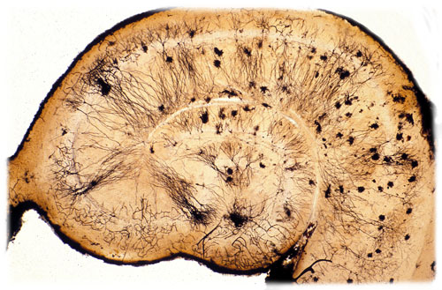
http://neural-prosthesis.com/index-1.html
-Link to images

Slide 8
The Biotech Implant
http://neural-prosthesis.com/index-1.html

Slide 9
Works Cited
http://neural-prosthesis.com/index-1.html
(Source of all pictures)
http://serendip.brynmawr.edu/exchange/node/1808

