Slide 1
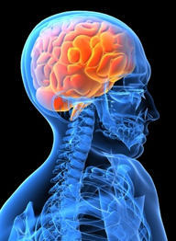
Brain Aneurysm
Using Polymers
Rachel Le
11/24/11

Slide 2
What is an Aneurysm?
weak area of an artery supplying the brain with blood expands or bulges, it is called an intracranial or brain aneurysm.
aneurysms burst, and blood from the leaking artery seeps into the brain in more than 30,000 people every year.

Slide 3
1 person in 15 in the United States will develop a brain, or cerebral, aneurysm during their lifetime.
Between 10 and 15 percent of them die before they get to a hospital, and more than half of the rest die within a month of the rupture. Half the survivors are paralyzed or suffer other neurological damage.

Slide 4
Brain aneurysms occur in people of every age, but they are most common between the ages of 30 and 60. Women are slightly more likely than men to experience a brain aneurysm.

Slide 5
Most common in…
inherited diseases
connective tissue disorders
some kidney diseases
certain circulatory disorders
Head trauma, some infections, high blood pressure and other circulatory system diseases can also cause aneurysms.

Slide 6
Symptoms if Aneurysms has not ruptured yet
Peripheral vision deficits
Thinking or processing problems
Speech complications
Perceptual problems
Sudden changes in behavior
Loss of balance and coordination
Decreased concentration
Short-term memory difficulty
Fatigue

Slide 7
Symptoms if Aneurysms has ruptured
Nausea and vomiting
Stiff neck or neck pain
Blurred vision or double vision
Pain above and behind the eye
Dilated pupils
Sensitivity to light
Loss of sensation

Slide 8
Usual Treatment
treated with surgery to expose Aneurysm
Closed off with a clip and removed
OR NONSURGICALLY
By inserting tiny spring-like platinum coils (dozen or more) into the Aneurysm
The cells that form the innermost layer of arteries (endothelial cells) grow over the clot healing.

Slide 9
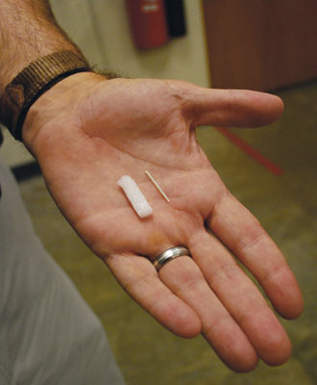
A new procedure
SMP
Size of ball can be calibrated to the size of Aneurysm
Ball has no parts to shift back into the artery to cause unwanted blood clots there.

Slide 10
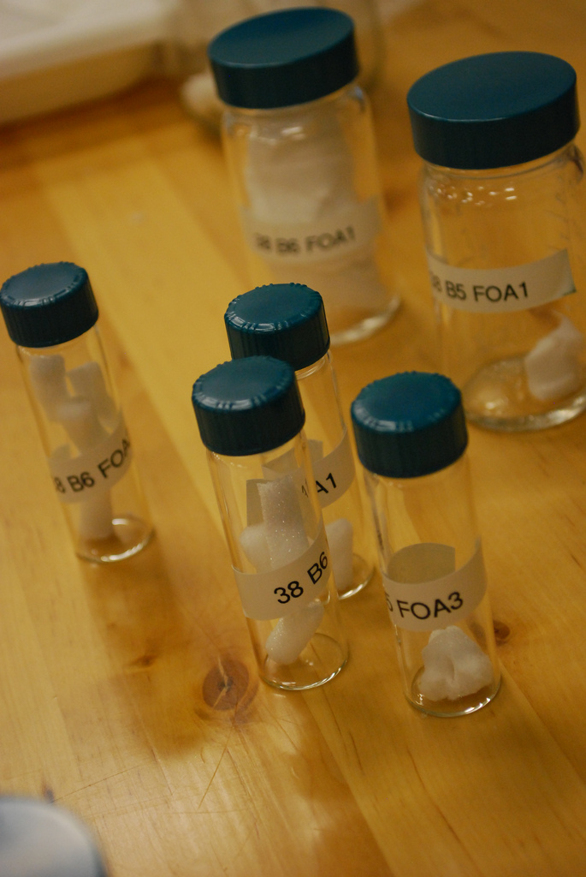
How is it inserted
To insert the balls requires pressing into a narrow cylinder pass through a catheter. Once through the catheter, the compressed SMP ball can be steered into the aneurysm, where a beam of laser light shone through an optical fiber in the catheter hits the SMP cylinder and causes it to return to its original ball shape, filling the aneurysm.

Slide 11
Comparing
Advantages
Disadvantages
Exerts no pressure on the walls and the risk of bursting is reduced
Minimal risk of infection
Not suitable for everyone
Only a research right now, not used in hospitals yet

Slide 12
Resources
http://en.wikipedia.org/wiki/Embolization#Disadvantages
http://engineering.tamu.edu/magazine/2010/plugging-aneurysms-with-polymers/
http://www.decodeme.com/brain-aneurysm
http://medicaldevice.wisc.edu/documents/MastersAneurysm.pdf
http://www.brainaneurysm.com/aneurysm-treatment.html

