Slide 1
LASIK Eye Surgery
BME 281 Presentation October 22nd, 2014
Michael McAfee

Slide 2
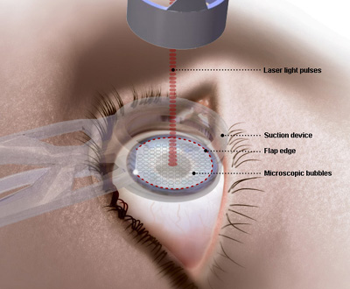
Problem being Solved
Refractive surgery corrects vision to eyes
LASIK – laser in-situ keratomileusis
Introduced in 1991
Restores vision to people that have
Myopia
Hyperopia
astigmatism

Slide 3
History
Radial Keratotomy – 1950 with doctor Tsutomu Sato
To correct nearsightedness with a series of incisions made to cornea
1970s with IBM researcher Doctor Srinivasin
Introduced Lasers to medical community
Photorefractive Keratectomy – 1983 with Doctor Steven Trokel & Srinivasin
Same procedure as radial except used with lasers , Preformed in Germany
LASIK Eye Surgery – 1991 with Greek doctor Ioannis Pallikaris

Slide 4
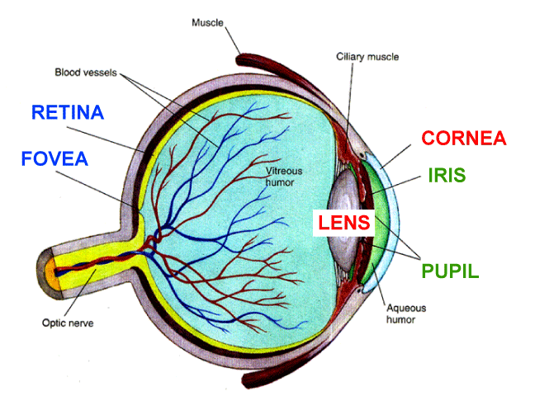
Pre - Procedure
Visit an eye doctor that will see if Lasik is right for you
Not all people qualify
IF yes:
Measure the shape / thickness of cornea
Pupil size
Moistness / chemical structure
Refractive errors

Slide 5
Surgery
Before surgery, numbing eye drops are put in eyes and eyes are held open with a surgical tool
A microkeratome (Laser) creates a thin, circular “flap” in the cornea (almost 300 degrees)
Surgeon will fold back flap to access underlying cornea (stromal)
To remove microscopic amounts of corneal tissue use an excimer laser
Uses cool UV light to reshape cornea
focuses light on retina for improved vision
Then cornea is put back into place, so that it can heal naturally

Slide 6
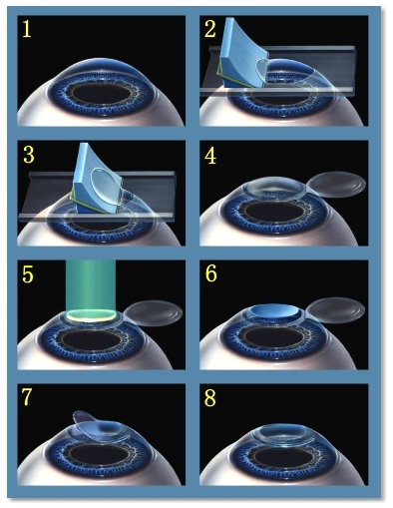
Goals
For nearsighted people:
FLATTEN CORNEA
For farsighted people:
MAKE CORNEA MORE STEEP
For People with astigmatism:
SMOOTH THE IRREGULAR CORNEA TO A NORMAL SHAPE

Slide 7
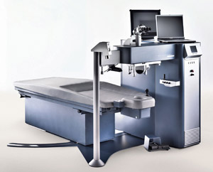
Laser Equipment
Manufactures by:
Summit Technology
Athens, AL
VisX
Santa Clara, CA
Nidek
Japan

Slide 8
Results
28 million people worldwide
Success rate is at 96%
Majority people achieve 20/20 or better
Very few achieve 20/40 or less
Recovery time is in a few days, just do not touch eyes
A small percentage may need ‘LASIK Enhancement’ or a ‘Touch-Up’

Slide 9
Side-effects/Limitations
Dry eyes
Seeing halos or specks of light
Permanent glare
Changes of vision throughout the day
Price
$1800-$3000 per eye
The fact that insurance does not cover it
With old age, eyesight can get worse
Once the changes are made, they cannot be undone

Slide 10
FUTURE
Look for a 100% success rate with 20/20 vision
Lower the price / more affordable
Speed up the recovery time
Make it available for everyone
Change standards of screening as technology advances

Slide 11
References
[1] "LASIK Laser Eye Surgery: Procedure, Recovery, and Side Effects." WebMD. WebMD, n.d. Web. 17 Oct. 2014. <http://www.webmd.com/eye-health/lasik-laser-eye-surgery>.
[2] Bellis, Mary. "The Tools of Laser Eye Surgery - Who Invented LASIK." About.com Inventors. About.com, n.d. Web. 17 Oct. 2014. <http://inventors.about.com/od/lstartinventions/a/Laser- Vision-Correction.htm>.
[3] Bores, Leo D., and Richard D. Smith. Refractive eye surgery. Boston: Blackwell Scientific Publications, 1993. Print.
[4] "A Complete Guide to the LASIK Procedure." All about Vision. n.d. Web. 19 Oct. 2014. <http://www.allaboutvision.com/visionsurgery
[5] Cole, J. (2012). Are You Losing Sight of LASIK?. Review of Optometry, 149(11), 53-86.

