Slide 1
SMF Helmet
Zachary Jacobson
Shante Dezrick
Riley Davis
Biomedical Engineering, URI September 26, 2014

Slide 2
Structure of presentation
Design Process
Clinical Studies
Future work

Slide 3
Design Process
Goals

Slide 4
Design Process
Concept
Static Magnets
  Rare-earth magnets
Able to reverse polarity
  Manual
  Wires/motor
  Mechanism
Placement must be flexible to meet patient needs
  4 target lobes of the brain
  Magnets fixed into pods
Notes:
Rare-earth magnets are up to ten times stronger than ferrite magnets and are the strongest type of fixed-magnets available on the public market

Slide 5
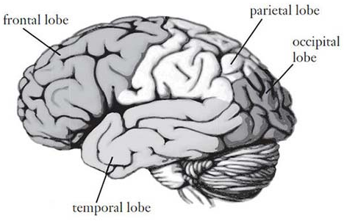
Figure 1
Target lobes of the brain. The front of the head is towards the left, the back is towards the right

Slide 6
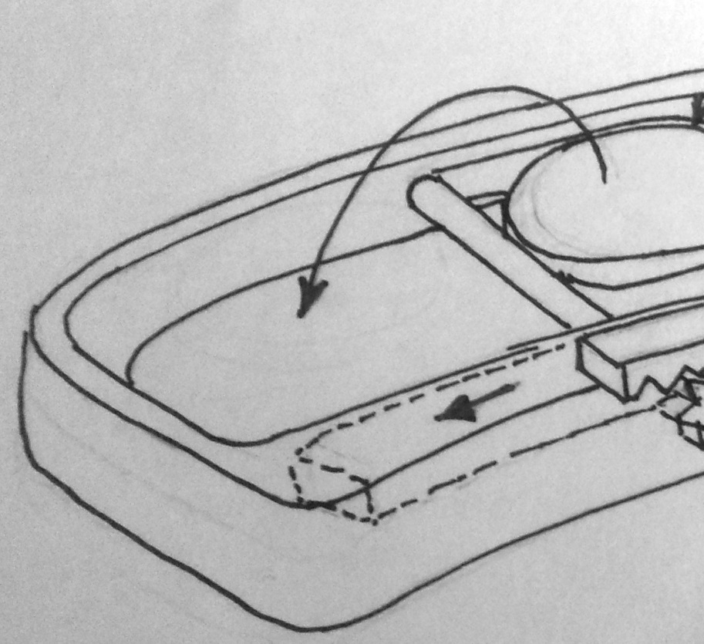

Design 1
Mechanical flip, independent magnet pod

Slide 7
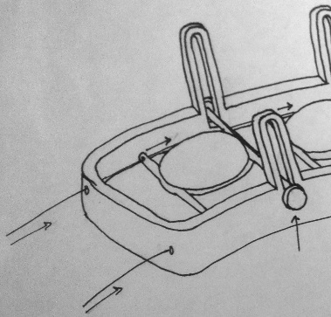

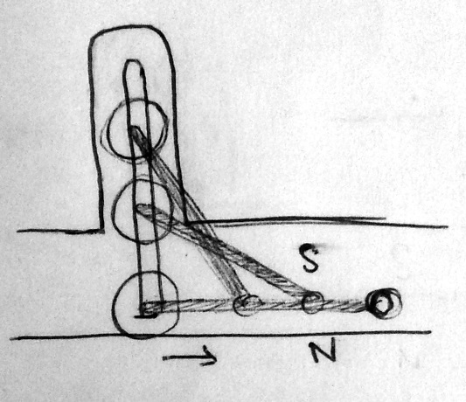
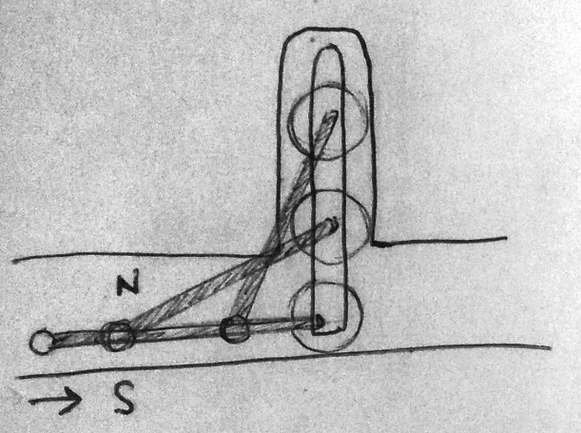
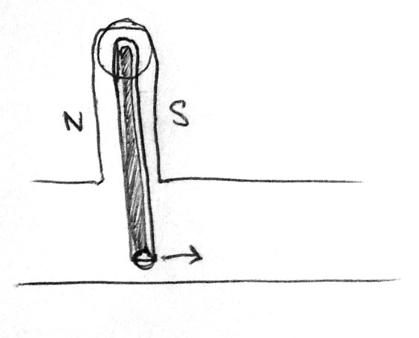
Design 2
Wire-rotated magnets, linear movement flexibility
Figure 2
Mechanism of action for Design 2

Slide 8
SolidWorks
3D Printing

Slide 9
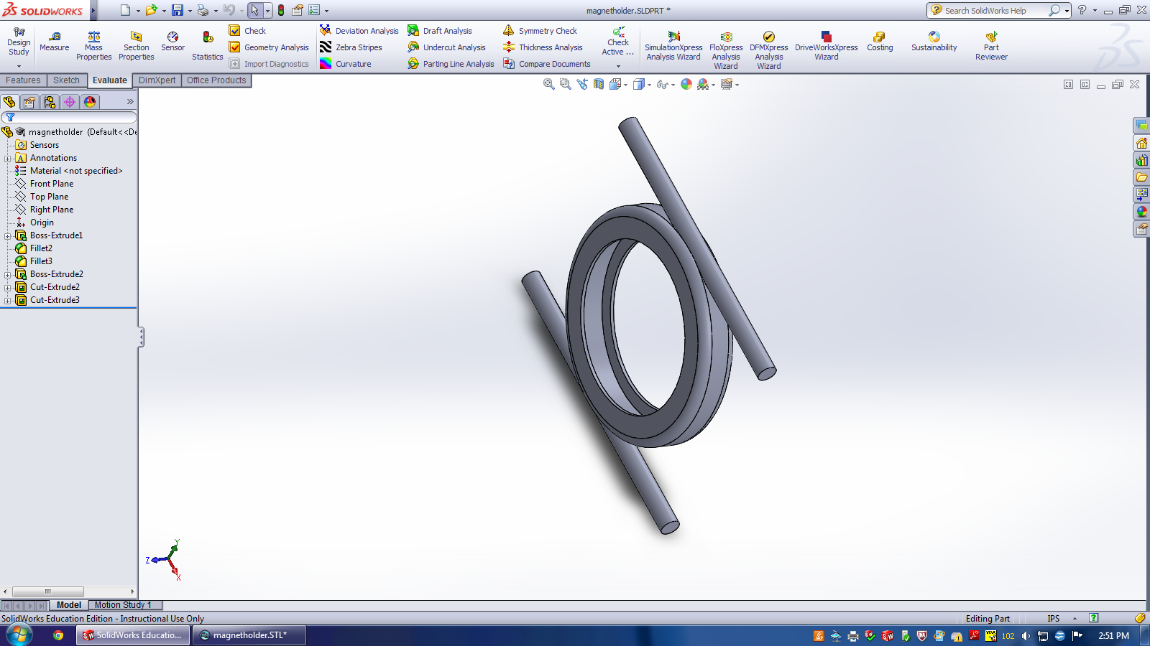
SolidWorks
3D Printing
Notes:
Shante: 3D CAD Design Software SOLIDWORKS

Slide 10
URI Clinical Studies
& Future Work

Slide 11
URI Clinical studies
Goals
IRB approval pending
15-30 person blind study
Two 1-hour sessions per person
  One full half-brain stimulation
  One sham
Looking for effect on short-term memory, hand-eye coordination, speed
Will be tested through a randomized, timed, dot-connecting game
Evaluated based on timing and accuracy

Slide 12
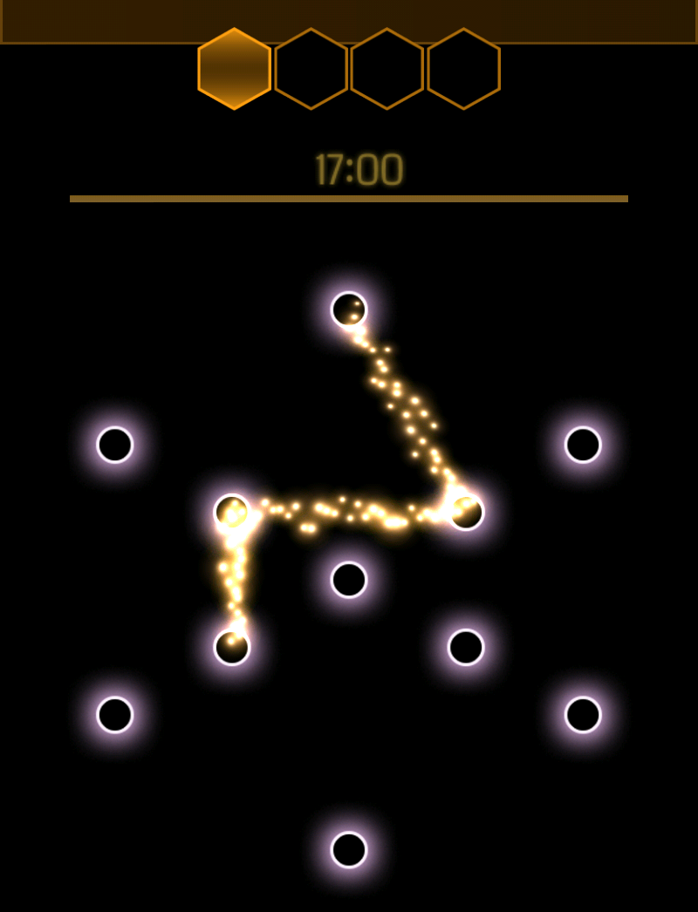
Figure 3
Designed in such a way that users will not get better scores through repetition of the game. This insures that the measured differences in accuracy and timing can be attributed to the SMF Helmet.
GUI for dot-connecting game to be used in clinical trial. It includes 4 sets of figures shown over 4 seconds. The user than has 17 seconds to correctly reproduce the 4 figures in order.

Slide 13
References
  Y. Levkovitz, E. V Harel, Y. Roth, Y. Braw, D. Most, L. N. Katz, A. Sheer, R. Gersner, and A. Zangen, “Deep transcranial magnetic stimulation over the prefrontal cortex: evaluation of antidepressant and cognitive effects in depressive patients.,” Brain Stimul., vol. 2, no. 4, pp. 188–200, Oct. 2009.
  L. Anderkova and I. Rektorova, “Cognitive effects of repetitive transcranial magnetic stimulation in patients with neurodegenerative diseases - clinician’s perspective.,” J. Neurol. Sci., vol. 339, no. 1–2, pp. 15–25, Apr. 2014.
  J.-P. Lefaucheur, “Treatment of Parkinson’s disease by cortical stimulation.,” Expert Rev. Neurother., vol. 9, no. 12, pp. 1755–71, Dec. 2009.
  M. Cotelli, R. Manenti, S. F. Cappa, O. Zanetti, and C. Miniussi, “Transcranial magnetic stimulation improves naming in Alzheimer disease patients at different stages of cognitive decline.,” Eur. J. Neurol., vol. 15, no. 12, pp. 1286–92, Dec. 2008.
  “NeuroStar TMS Therapy Depression Treatment.” [Online]. Available: http://neurostar.com/. [Accessed: 10-Sep-2014].
  A. P. Colbert, H. Wahbeh, N. Harling, E. Connelly, H. C. Schiffke, C. Forsten, W. L. Gregory, M. S. Markov, J. J. Souder, P. Elmer, and V. King, “Static magnetic field therapy: a critical review of treatment parameters.,” Evid. Based. Complement. Alternat. Med., vol. 6, no. 2, pp. 133–9, Jun. 2009.
  J. M. D. Coey, “Rare-earth magnets,” Endeavour, vol. 19, no. 4, pp. 146–151, Jan. 1995.
  A. T. Sack, R. Cohen Kadosh, T. Schuhmann, M. Moerel, V. Walsh, and R. Goebel, “Optimizing functional accuracy of TMS in cognitive studies: a comparison of methods.,” J. Cogn. Neurosci., vol. 21, no. 2, pp. 207–21, Feb. 2009.
  A. Aleman and M. van’t Wout, “Repetitive transcranial magnetic stimulation over the right dorsolateral prefrontal cortex disrupts digit span task performance.,” Neuropsychobiology, vol. 57, no. 1–2, pp. 44–8, Jan. 2008.
  Y. Levkovitz, Y. Roth, E. V. Harel, Y. Braw, A. Sheer, and A. Zangen, “A randomized controlled feasibility and safety study of deep transcranial magnetic stimulation.,” Clin. Neurophysiol., vol. 118, no. 12, pp. 2730–44, Dec. 2007.

