Slide 1
SpinDx: A New Medical Diagnosis Tool
Maraquia Atwood

Slide 2
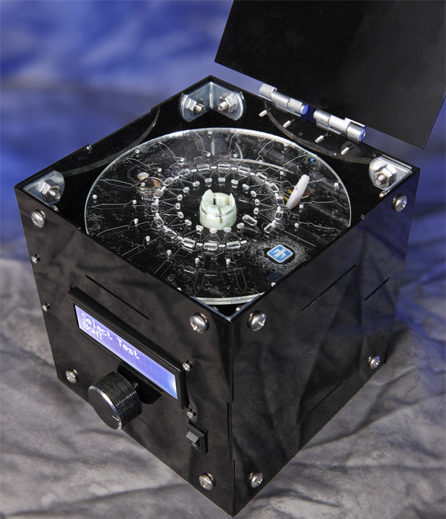
The SpinDx
Developed by Sandia National Laboratories
Uses a touch screen system
Blood samples are mixed on the disk with labeling agents
Cells separate along a pre-loaded density media
Miniaturized fluorescent optics are used for detection.

Slide 3
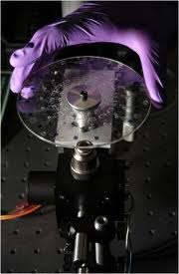
Benefits
Requires less blood per test sample
Can process up to 64 samples at a time
Processes samples in 15 minutes
Extremely portable
Disks are manufactured very cheaply

Slide 4
Applications
Used with human and animal samples-whole blood samples, saliva, urine
Food and Environmental Monitoring-water, soup, milk, vegetables, peanut butter
Biological-terrorism Defense
Commercial Drug Testing Markets

Slide 5
Questions

