Slide 1
Nanotechnology and cancer
Maria Guirguis
Dr. Sun
Biomedical Engineering Seminar 1

Slide 2
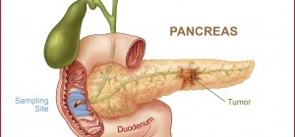
What is cancer?
Cancer is the disease caused by an uncontrolled division of abnormal cells in a part of the body.
Chemotherapy is the treatment that comes to mind right away.

Slide 3
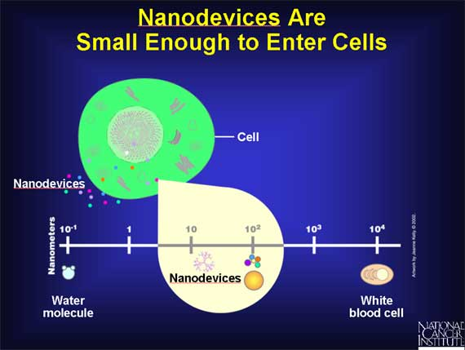
Nanotechnology
Nanotechnology is the manipulation of matter at the atomic and molecular scale to create materials with new and advanced properties.

Slide 4
Nanotechnlogy
Nanotechnology integrates medicine and engineering in order to help advance quickly advance the world of medicine

Slide 5
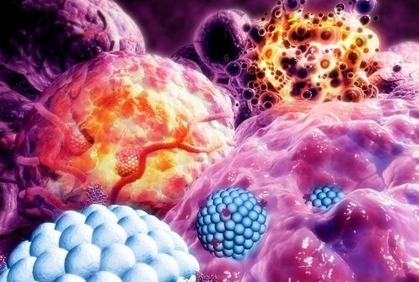
Nanoparticle
Gold nanoparticles are emerging as promising agents for cancer therapy and are being investigated as drug carriers, photothermal agents, contrast agents and radiosensitisers.

Slide 6
Process
Once the nanoparticle has safely traveled through the blood stream, it binds to the tumor cell.

Slide 7
One of the many studies done

Slide 8
Advantages of Nanotechnology
Protects drugs from being degraded in the body before they reach their target.
Enhances the absorption of drugs into tumors and into the cancerous cells themselves.
Allows for better control over the timing and distribution of drugs to the tissue, making it easier for oncologists to assess how well they work.
Prevent drugs from interacting with normal cells, thus avoiding side effects.

Slide 9
Disadvantages of Nanotechnology
Atomic weapons can now be more accessible and made to be more powerful and more destructive. These can also become more accessible with nanotechnology.
Since these particles are very small, problems can actually arise from the inhalation of these minute particles, much like the problems a person gets from inhaling minute asbestos particles.
Presently, nanotechnology is very expensive and developing it can cost you a lot of money. It is also pretty difficult to manufacture, which is probably why products made with nanotechnology are more expensive.

Slide 10
Where Nanotechnology Stands Now
In recent years, the U.S. Food and Drug Administration (FDA) has approved numerous Investigational New Drug (IND) applications for nano-formulations, enabling clinical trials for breast, gynecological, solid tumor, lung, mesenchymal tissue, lymphoma, central nervous system and genito-urinary cancer treatments.

Slide 11
Works Cited
http://science.howstuffworks.com/life/human-biology/gold-nanotech1.htm
http://bjr.birjournals.org/content/85/1010/101.full.pdf>
http://web.mit.edu/newsoffice/2010/nanoparticle-chemotherapy-1005.html>.
http://nano.cancer.gov/learn/now/
http://www.wired.co.uk/news/archive/2012-10/16/gold-nanoparticles-cancer-dogs
http://nano.cancer.gov/learn/now/

