Slide 1
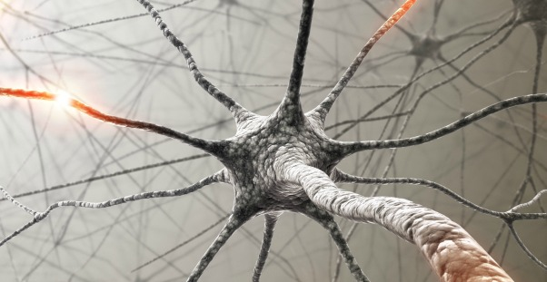
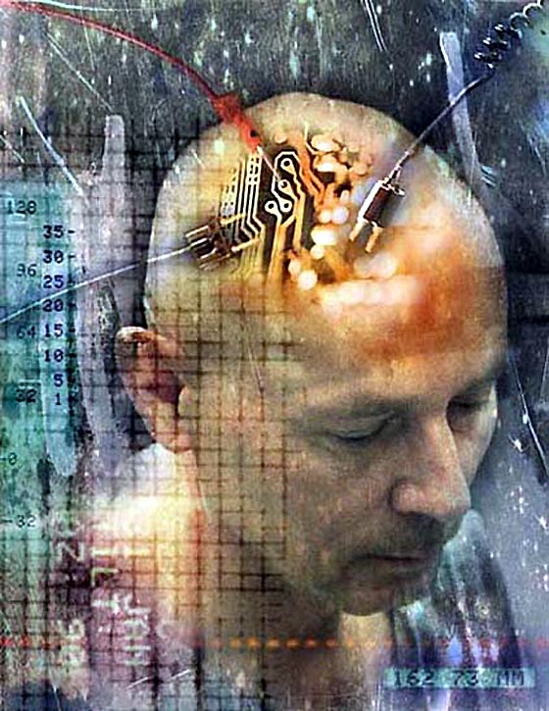
Neurotechnology
By Brett Kotowski
BME Section 2 Presentation 1

Slide 2
Neurotechnology
Neurotechnology is the use of engineering applications to scan, alter or enhance the brain, or other neurological systems.
Neurotechnolgy spans across a variety of different medical areas including medical imaging, exterior brain monitoring, implant technologies, and pharmaceuticals.

Slide 3
Medical Imaging in Neurotechnology
Functional Magnetic Resonance Imaging(MRI): Used to study the topological structure of the brain by targeting the higher oxygen levels in the brain.
Computed Topography(CT) Scan: CT-Scans are used to detect brain-activation as well as brain-injuries such as aneurysms or cancer.
Positron Emission Topography(PET) Scan: PET-Scans are bound to levels of nutrients in the brain, the lower the level of nutrients the brighter the image will appear.

Slide 4
Exterior Brain Monitoring
Exterior brain monitoring involves all possible ways of observing the brain, while at the same time being non-invasive to the patient.
Electroencephalography measures brain-activity by placing a number of electrodes around the head and scalp to measure electrical signals in the brain.
Magneto encephalography measures the magnetic fields that come from the electric currents in the brain, and shows where certain areas of the brain activated the most due to stimulation.

Slide 5
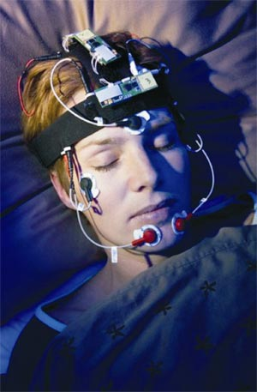
Electroencephalography

Slide 6
Implant Technologies
Neuro-modulation: An implanted device in the neurological system, that is surgically installed sends out an electrical stimulation to control an existing part of the nervous system; Spinal Chord Stimulation or Gastric Stimulation.
Neural Prosthesis: Used to improve function of an impaired limb or organ. It is installed surgically at the sight of the injury, and is designed to function as that organ or limb would by reacting to nerve impulses from the brain.

Slide 7
Brain-Gate Test
Brain-Gate was a test conducted by a collaboration of researchers from the Department of Veteran Affairs, Brown University, Harvard Medical School, Massachusetts General Hospital, and the German Aerospace Center. The test was done on two patients that had suffered from brain-stem strokes years ago, and are now both paralyzed.
A device, with a grid of 96 tiny electrodes is implanted in the brain.
This device is connected to a robotic arm, and translates the neural impulses from the device into commands for three-dimensional motion with the robotic arm.

Slide 8
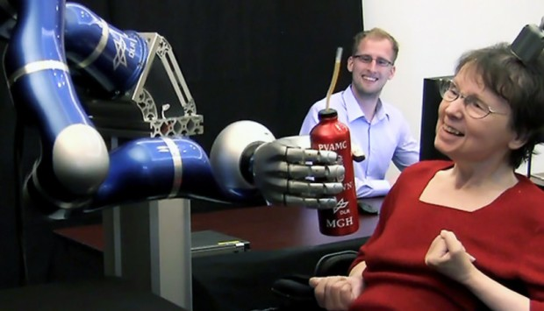
Patient using thought-controlled Robotic arm

Slide 9
Pharmaceutical Neurotechnology
Pharmaceuticals are the most common use of Neurotechnology by the general public.
These pharmaceuticals are anything that ultimately alters the way the brain functions including medicine that treats attention deficit disorder, or depression.

Slide 10
Works Cited
Neurotech network. N.p., 2009. Web. 12 Mar. 2013. <http://www.neurotechnetwork.org/pdf/Technology_Frontier_Neurotech.pdf>.
"People with paralysis Conrol Robotic Arms to Reach and Grasp Using Brain Computer Interface." General OneFile. Gale, 2012. Web. 12 Mar. 2013. <http://go.galegroup.com/ps/i.do?id=GALE%7CA320763721&v=2.1&u=mlin_n_stonehs&it=r&p=AONE&sw=w>.
Wikipedia. N.p., n.d. Web. 12 Mar. 2013. <http://en.wikipedia.org/wiki/Neurotechnology>.
wise GEEK. N.p., n.d. Web. 12 Mar. 2013. <http://www.wisegeek.com/what-is-neurotechnology.htm>.

