Slide 1
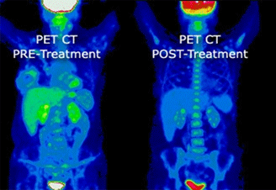
Positron Emission Tomography (Pet)
By: Morgan Hammick
BME 181 Section 2

Slide 2
What is a PET scan?
A positron emission tomography scan is an imaging test that uses a radioactive substance called a tracer to look for disease in the body
A PET scan shows how organs and tissues are working

Slide 3
How it works
The PET produces images of the body by detecting the radiation emitted from radioactive substances.
  These substances are injected into the body, and are usually tagged with a radioactive atom
The PET detects the gamma rays
http://www.youtube.com/watch?v=tZ9n-8L4JKM

Slide 4
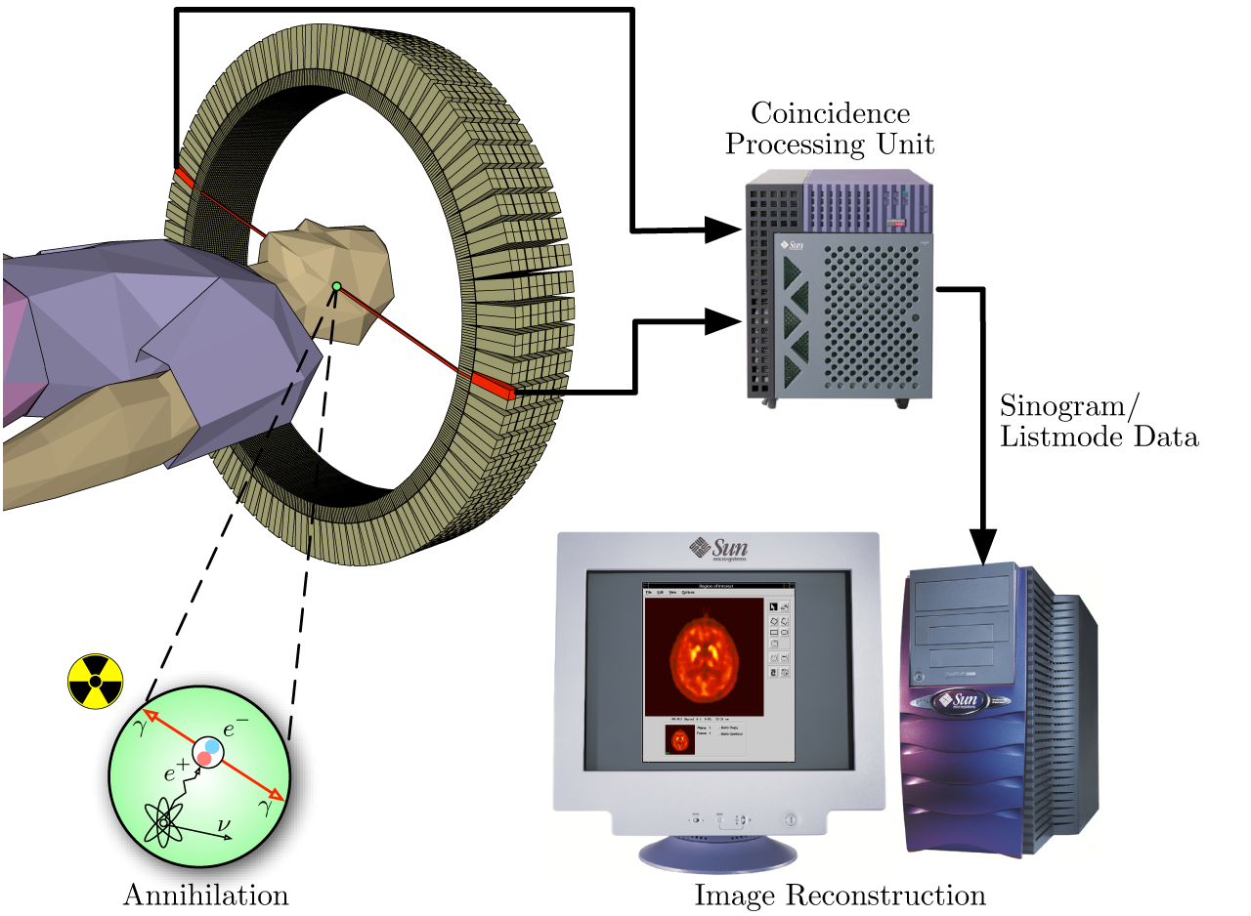

Slide 5
Procedure
No eating for 4-6 hours prior
The tracer is given through an IV
Wait about an hour
Lie on table that slides into the scanner
The scanner picks up signals from the tracer
Stay very still

Slide 6
Why Get a PET Scan?
It can reveal the size, shape, position, and some function of organs
Test can be used to:
  Check brain function
  Diagnose cancer, heart problems, and brain disorders
  See how far cancer has spread
  Show areas in which there is poor blood flow to the heart

Slide 7
Risks
Minimal radiation is used
  Short-lived tracers are used
Tell doctor if you’re pregnant or breast feeding
Allergic reaction to the tracer material is rare
Some people experience redness, pain, or swelling at the injection site

Slide 8
Costs
Cost of scan: $3,000 - $6,000
  Broken down into 3 areas
    FGD Radiopharmaceutical Fees (~$527)
    Technical Fees ($206-$939)
    Professional Fees (~$1,880)
Expensive, but could be worth it
The machine its self is usually around $1.9 million

Slide 9
Works Cited
"Compare PET Scan Cost." PET Scan Cost and Pricing Information. N.p., n.d. Web. 27 Mar. 2013.
Dugdale, David C. "PET Scan: MedlinePlus Medical Encyclopedia." U.S National Library of Medicine. U.S. National Library of Medicine, 9 Nov. 2012. Web. 26 Mar. 2013.
Freudenrich, Ph.D., Craig. "How Nuclear Medicine Works" 18 October 2000. HowStuffWorks.com. <http://science.howstuffworks.com/nuclear-medicine.htm> 26 March 2013.
"How Much Does a Positron Emission Tomography Machine Cost?" Yahoo! Answers. Yahoo!, 2009. Web. 27 Mar. 2013.
Positron Emission Tomography (PET) at the Helmholtz-Zentrum Dresden-Rossendorf. Youtube. Helmholtz-Zentrum Dresden-Rossendorf, n.d. Web. 26 Mar. 2013.

