Slide 1
Effectively Mitigating I/O Inactivity in vCPU Scheduling
Weiwei Jia¹², Cheng Wang¹, Xusheng Chen¹, Jianchen Shan², Xiaowei Shang², Heming Cui¹, Xiaoning Ding², Luwei Cheng³, Francis C. M. Lau¹, Yuexuan Wang¹, Yuangang Wang⁴
Hong Kong University¹, New Jersey Institute of Technology², Facebook³, Huawei⁴

Slide 2
VM consolidation is pervasive in clouds
Physical Machine (PM 1)
PM n
Virtual Machine (VM 1)
VM 2
. . .
Virtual Machine Monitor (VMM)
Consolidation benefits:
Ease management
Save energy
Improve resource utilization and system throughput

Slide 3
Multiple vCPUs are scheduled to time-share a pCPU
Physical Machine
VM 1
VM 2
vCPU1
vCPU2
vCPU3
vCPU4
vCPU1
vCPU2
vCPU3
vCPU4
VMM
pCPU1
pCPU2
pCPU3
pCPU4
Physical CPU (pCPU): hardware resources
Virtual CPU (vCPU): processors in VM, threads in VMM
Multiple vCPUs sharing one pCPU is often
E.g., VMWARE suggests 8-10 vCPUs to share one pCPU

Slide 4
Multiple vCPUs are scheduled to time-share a pCPU
T0
T1
T2
Physical Machine
VM 1
VM 2
Time
active
vCPU1 in VM1
vCPU1
vCPU2
vCPU3
vCPU4
vCPU1
vCPU2
vCPU3
vCPU4
inactive
VMM
pCPU1
pCPU2
pCPU3
pCPU4
active
vCPU1 in VM2
inactive
Physical CPU (pCPU): hardware resources
Virtual CPU (vCPU): processors in VM, threads in VMM
vCPU scheduler schedules and deschedules vCPUs periodically

Slide 5
An understudied problem: I/O inactivity
T0
T1
T2
Physical Machine
VM 1
VM 2
Time
active
VM1
vCPU1
activity
vCPU1
vCPU2
vCPU3
vCPU4
vCPU1
vCPU2
vCPU3
vCPU4
VMM
active
inactive
HDFS I/O
activity
on vCPU1
pCPU1
pCPU2
pCPU3
pCPU4
inactive
I/O request
No I/O requests can be issued on an inactive vCPU
Underutilization of I/O device

Slide 6
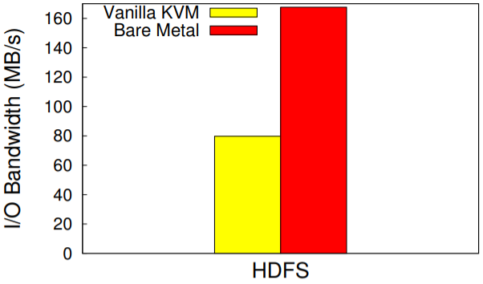
I/O inactivity causes low I/O performance in VMs
Physical Machine
VM 1
VM 2
vCPU1
vCPU2
vCPU3
vCPU4
vCPU1
vCPU2
vCPU3
vCPU4
VMM
pCPU1
pCPU2
pCPU3
pCPU4
VM1 can only use 50% of I/O bandwidth even when VM2 does not use I/O device.
I/O throughput of HDFS in VM1 is only 55% of that on bare-metal.

Slide 7
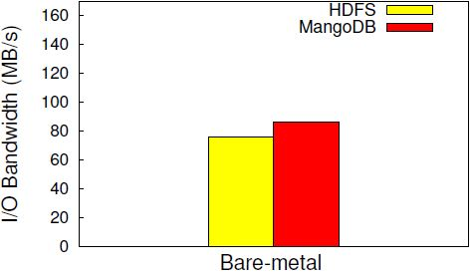
I/O scheduler cannot effectively enforce fairness between VMs
Physical Machine
Operating System
pCPU1
pCPU2
pCPU3
pCPU4
Two I/O-intensive applications (HDFS and MongoDB) show similar I/O throughput on bare-metal

Slide 8
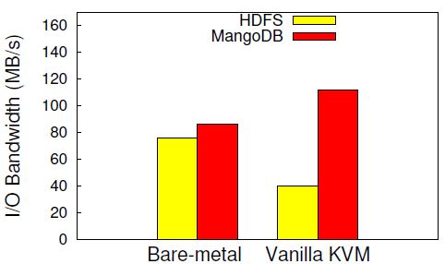
I/O scheduler cannot effectively enforce fairness between VMs
Physical Machine
VM 1
VM 2
vCPU1
vCPU2
vCPU3
vCPU4
vCPU1
vCPU2
vCPU3
vCPU4
VMM
pCPU1
pCPU2
pCPU3
pCPU4
VM1 and VM2 are assigned with the same I/O priority, but MongoDB (VM2) achieves much higher I/O throughput.
vCPUs running I/O tasks in MongoDB in VM2 have more time slice to run.
vCPUs running HDFS in VM1 have less time slice to run

Slide 9
Key: decouping I/O activities from vCPU scheduling
active
I/O request
active
Blue line: vCPU activity
Black line: I/O activity
Vanilla KVM
inactive
inactive
vSlicer[HPDC’12]
inactive
inactive
inactive
inactive
xBalloon[SoCC’17]
inactive
inactive
I/O activity bare-metal
9

Slide 10
Can we decouple I/O activities from vCPU scheduling?
Our answer is YES!
Key observation: each VM often has active vCPUs
Solution: keep I/O tasks on active vCPUs
- Migrate an I/O task when its vCPU is about to be descheduled
- Migrate the I/O task to a vCPU that is NOT to be descheduled soon.
Benefits: I/O tasks can make continuous progress like on bare-metal
- Migration can be efficient because I/O tasks usually have small working sets.
10

Slide 11
vMigrater: a user-level design
I/O-bound Task
VM
CPU-bound Task
vCPU Monitor
Task Detector
To be descheduled
vMigrater
T0
T1’
T1
T2
Task Migrater
Time
active
vCPU1
activity
vCPU1
vCPU2
vCPU3
inactive
Hypervisor
vCPU Scheduler
vCPU3
activity
pCPU1
pCPU2
NOT to be descheduled soon.
11

Slide 12
Challenges with the user-level design (1/3) - How to detect I/O tasks quickly?
Existing resource monitors cannot respond to execution phase changes quickly
- eg., Linux top and iotop refresh measurements periodically every a few seconds
- Applications often have bursty I/O phases finished within a refreshing period.
Event-driven method in vMigrator
- Monitor I/O events time at OS block I/O layer
- Calculate the fraction between the I/O events time and the whole period
- respond quickly when task becomes I/O intensive (<1 millisecond)
12

Slide 13
Implementation challenges (2/3) - when to migrate?
When the vCPUs are to be inactive
Naïve approach: monitor inactive/active vCPUs in hypervisor layer: not secure and portable
Our approach
- a heartbeat-like mechanism: timer events as heartbeats
- a vCPU cannot process timer events when it is inactive
- vCPU time slice: timer differences between the start timer and end timer when the vCPU is active
13

Slide 14
Challenges with the user-level design (3/3) - migrate to which vCPU(s)?
Migrate to vCPUs with enough remaining time slice
Estimation of time slice still relies on the heartbeat-like mechanism
Naïve approach: consolidate all I/O tasks to the vCPU with the longest remaining time slice
- Problem: the vCPU may be overloaded
Our approach: distribute I/O tasks to vCPUs based on I/O workload and remaining time slice.
- tasks with heavier I/O workload on vCPUs with more time slice
14

Slide 15
Experimental Setup
Dell PowerEdge R430 with 12 cores, a 1TB HDD, and a 1TB SSD
Both VMs and VMM (linux QEMU/KVM) use Ubuntu Linux 16.04
Each VM has 12 vCPUs and 4GB DRAM
Compared with vSlicer [HPDC’12] and xBalloon [SoCC’17]
15

Slide 16
Evaluation applications and workloads
Application | Workload
HDFS | Sequentially read 16GB with HDFS TestDFSIO
LevelDB | Randomly scan table with db_bench
MediaTomb | Concurrent requests on teanscoding a 1.1GB video
HBase | Randomly read 1GB with Hbase PerfEval
PostMark | Concurrent requests on a mail server
Nginx | Concurrent requests on watermarking images
MongDB | Sequentially scan records with YCSB
16

Slide 17
Evaluation questions
How much performance improvement can be achieved with vMigrater, compared with vanilla KVM and two related systems?
Can vMigrater help the I/O scheduler in the VMM to achieve fairness between VMs?
How robust is vMigrater to varying workloads?
What is the overhead incurred by vMigrater?
What is vMigrater’s performance when the workload in a VM varies over time
How does vMigrater scale to the number of shared vCPUs on a pCPU?
17

Slide 18
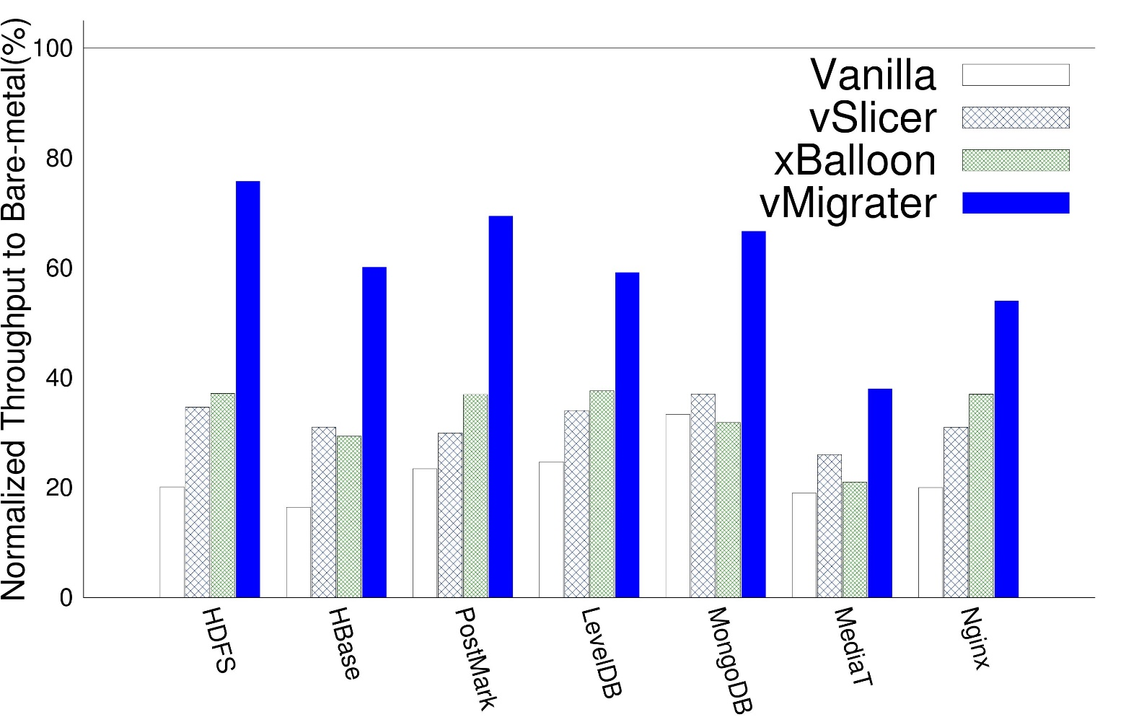
Throughput on seven applications (4 vCPUs sharing per pCPU)
vMigrater’s throughput is 192% higher than Vanilla KVM, 75% higher than vSlicer,
84% higher than xBalloon on average
18

Slide 19
HDFS performance analysis
HDFS | Vanilla | vSlicer | xBalloon | vMigrater
I/O inactivity time (seconds) | 121.82 | 92.91 | 75.27 | 6.62
19

Slide 20
MediaTomb performance analysis
HDFS | Vanilla | vSlicer | xBalloon | vMigrater
I/O inactivity time (seconds) | 121.82 | 92.91 | 75.27 | 6.62
MediaTomb | Vanilla | vSlicer | xBalloon | vMigrater
I/O inactivity time (seconds) | 108.61 | 89.46 | 116.96 | 34.95
vMigrater has big I/O inactivity periods on MediaTomb
MediaTomb combine computation and I/O in each thread so the migration cost is higher
20

Slide 21
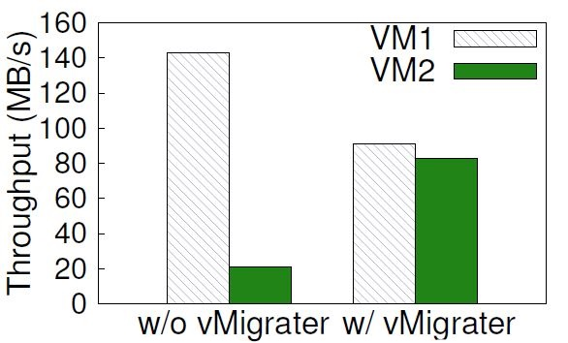
Fairness of I/O Scheduler in VMM
Physical Machine
VM 1
VM 2
vCPU1
vCPU2
vCPU3
vCPU4
vCPU1
vCPU2
vCPU3
vCPU4
VMM
pCPU1
pCPU2
pCPU3
pCPU4
21

Slide 22
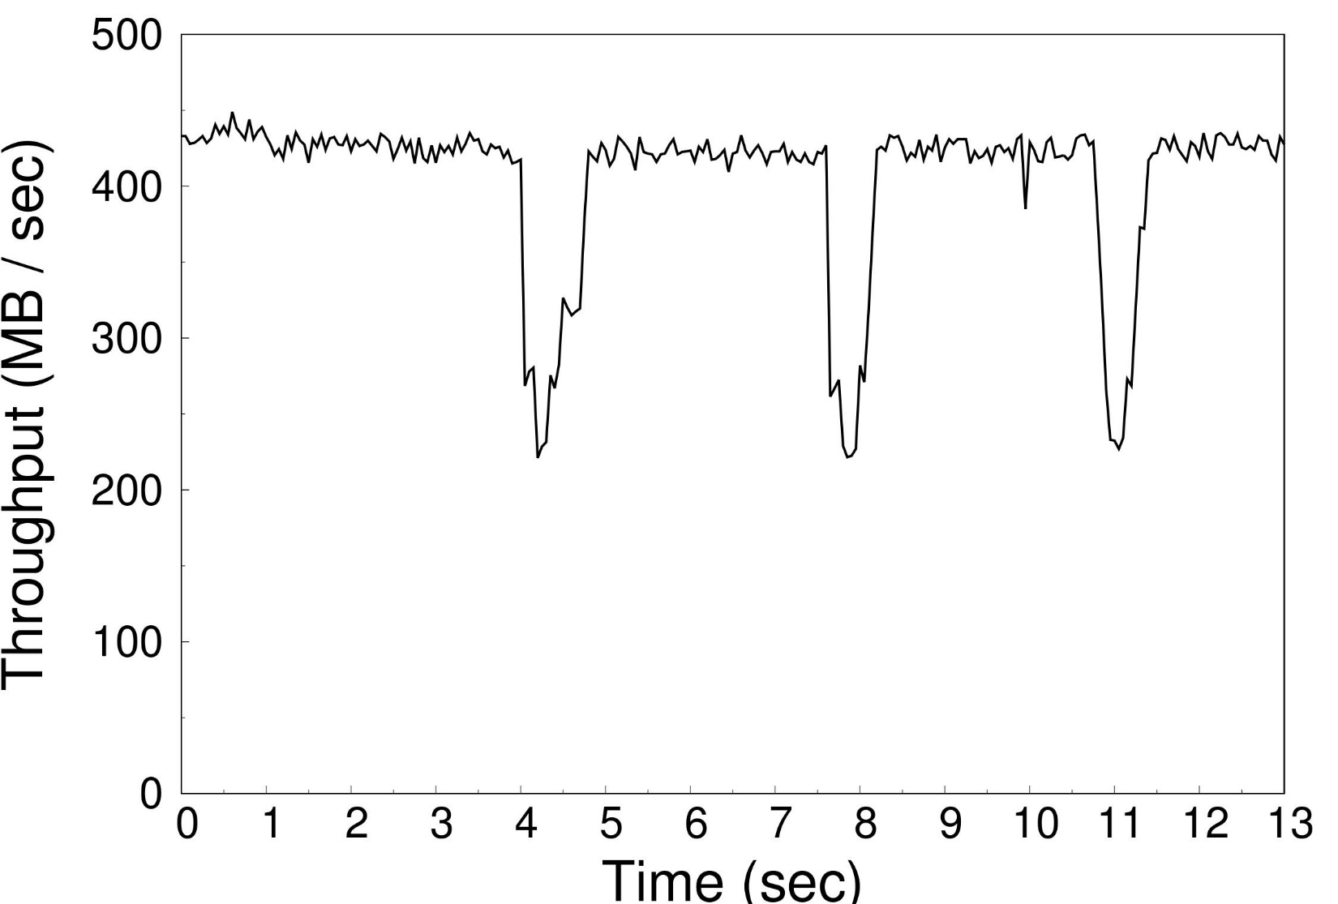
Robustness to varying workloads
Added 4 clients
Added 8 clients
Added 16 clients
22

Slide 23
Conclusions
I/O inactivity problem
- Performance degradation
- I/O scheduler unfairness
vMigrater: effectively mitigating I/O inactivity problem
- Performance is close to bare-metal
- Regain fairness
vMigrater’s source code: https://github.com/hku-systems/vMigrater
23

Slide 24
Thank you
Questions?
24

